Slide 1
Using a Task Analysis Smart Phone App to Teach Employment & Independent Living Skills
to Individuals with Intellectual Disabilities
Sharon Walters, MA, CCC-SLP
Jordan Stierle, M.Ed.
Clemson University
CEC CCC PD Learning Day
June 25, 2020

Slide 2
Agenda
Introduction & Brief Overview of ClemsonLIFE
Overview of Video Prompting
Task Analysis App Demonstration

Slide 3
ClemsonLIFE (Learning Is For Everyone)
Is a post-secondary program for students with intellectual disabilities which focuses on independent living skills and employment.

Slide 4
What Does The Research Say About Independent Living for Individuals with ID?
17.6% live in their own home or apartment.
34.3% live with a parent or relative in a private home.
These dismal rates of independent living are largely due to challenges faced by individuals with ID in performing daily living skills (Hiersteiner, Butterworth, Bershadsky, & Bonardi, 2018).

Slide 5
What Does The Research Say About Employment for Individuals with ID?
14.9% have an individual job in the community.
20.2% have a supported job in the community.
61.9% are engaged in unpaid facility-based or community-based activities.
(Hiersteiner, Butterworth, Bershadsky, & Bonardi, 2018).

Slide 6
What is the connection between independent living and employment for individuals with ID?
(Hiersteiner, Butterworth, Bershadsky, & Bonardi, 2018).

Slide 7
What is the connection between independent living and employment for individuals with ID?
(Hiersteiner, Butterworth, Bershadsky, & Bonardi, 2018).

Slide 8
What are Daily Living Skills?
Daily living skills entail:
personal (i.e., eating, dressing, toileting)
domestic (i.e., cooking, laundry, cleaning)
community skills (i.e., time management, money management, use of technology)
(Hong et al., 2015)

Slide 9
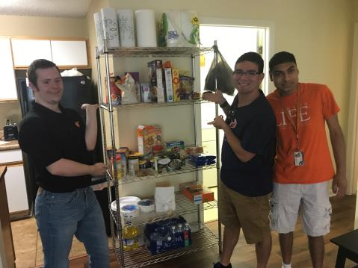
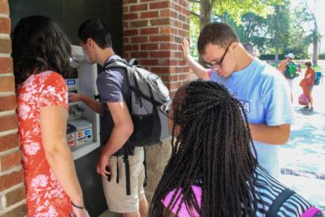
ClemsonLIFE Daily Living Skills and Employment
Daily Living Skills
Grocery Shopping
Managing a Budget
Navigating Transportation
Cooking
Cleaning
Time Management
Employment
Year 1- Internship rotation
Year 2- Individual internship
Year 3 and 4- Paid position

Slide 10
The Challenge
Most daily living skills and employment tasks involve multiple steps to complete a task
Challenges for individuals with ID
Remembering the task sequence
Remembering the materials needed
Following the sequential steps

Slide 11
Task Analysis
Effective in teaching multi-step tasks to individuals with ID
Daily living skills (Szidon & Franzone, 2009)
Employment skills (Randall et al., 2019; Walters et al., 2020)
Breaks down a skill into smaller, more manageable steps.
1. Separate laundry from dark and light 5. Close the lid of the washer
2. Load laundry into the machine 6. Select the normal setting
3. Measure the soap in the cap 7. Press start to begin the cycle
4. Pour soap into washing machine

Slide 12
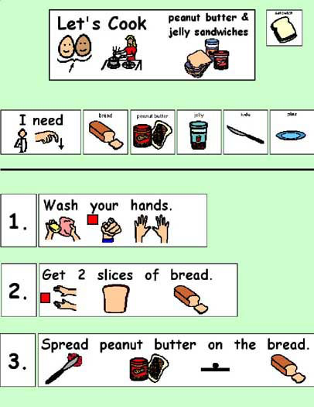
Boardmaker
*How many remember task sequences with Boardmaker pics?
*How many have used it or are still using it?
This is Task Analysis!

Slide 13
Task Analysis with Video Prompting
Evidence-based instructional technique
2 parts
Watch a video of a model or themselves perform a step of a task
Complete the task
Advantages
Repeat the step
Continue until the task is complete

Slide 14
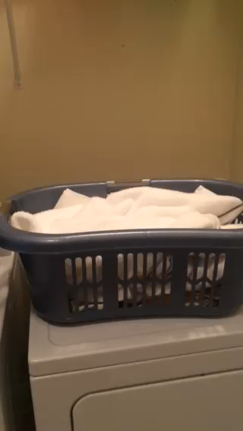
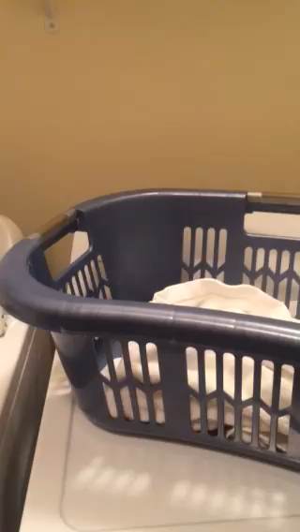
Video Prompting
Each step is recorded with a narrated step by step explanation.
Step 1
Step 2
Notes:
jc
Video prompting resulted in a higher level of performance than video modeling. This may due to the fact that video prompts are generally only about 10 to 20 seconds which may help compensate for cognitive and memory issues.

Slide 15
Self-Prompting with Video Prompting
Form of self-management
Individual uses a prompt to remind themselves of a step they need to perform to complete a task
Types
Text
Picture
Auditory
Video
Briggs et al., 1990; Van Laarhoven et al., 2010

Slide 16
Video Prompting with Mobile Technology
Initially video prompting used a computer or a VCR
Today more often used with handheld devices
Convenient
Variety of features for accessing and using videos (i.e., apps)
Accessible in variety of locations (e.g., home, community)
Discrete
Inclusive
(Cihak et al., 2007)

Slide 17
Video Prompting with Daily Living Skills
Effective tool to teach a variety of daily living skills
Cooking (Graves et al., 2005)
Household chores (Cannella-Malone et al., 2006;Van Laarhoven & Van Laarhoven-Myers, 2006)
Shopping (Van Laarhoven et al., 2009)

Slide 18
Video Prompting with Employment Skills
Effective tool to teach a variety of daily living skills
Pet store, campus recreation center, and dental clinic (Cullen et al., 2017)
Animal shelter (Van Laarhoven et al., 2009)
School cafeteria (Douglas & Uphold, 2014)
Office settings (Collins et al., 2014; Van Laarhoven et al., 2018)

Slide 19
Meta-Analysis Results of Video Prompting for Individuals with ID Performing Daily Living Skills
Medium/large effect size gains:
PND 90%
PEM 96%
Tau-U 0.90

Slide 20
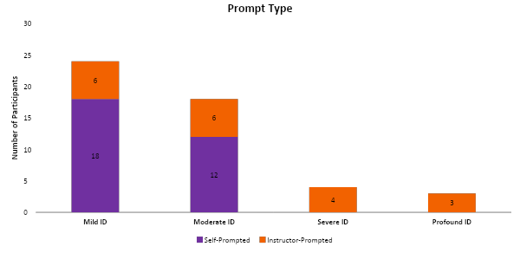
Level of Intellectual Disability & Prompt Type
49% mild
37% moderate
8% severe
6% profound

Slide 21
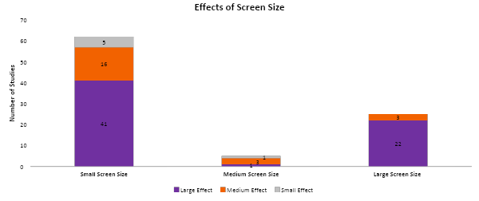
Screen Size
Larger screen sizes were more effective, but smaller screen sizes were used more often.

Slide 22
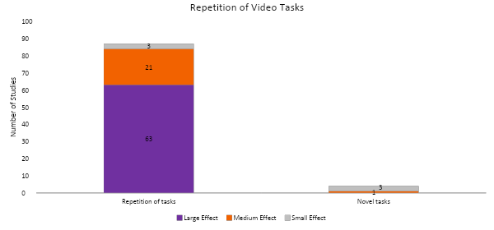
Task Repetition
Allow students to use the same video prompts repeatedly.

Slide 23
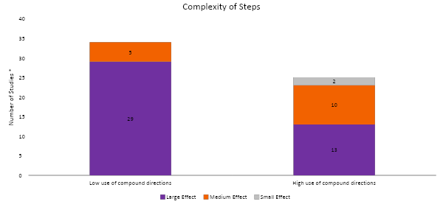
Complexity of Steps
Use short, simple sentences but provide all the necessary information.

Slide 24
Task Analysis LIFE App
Navigating the App
Notes:
tr

Slide 25
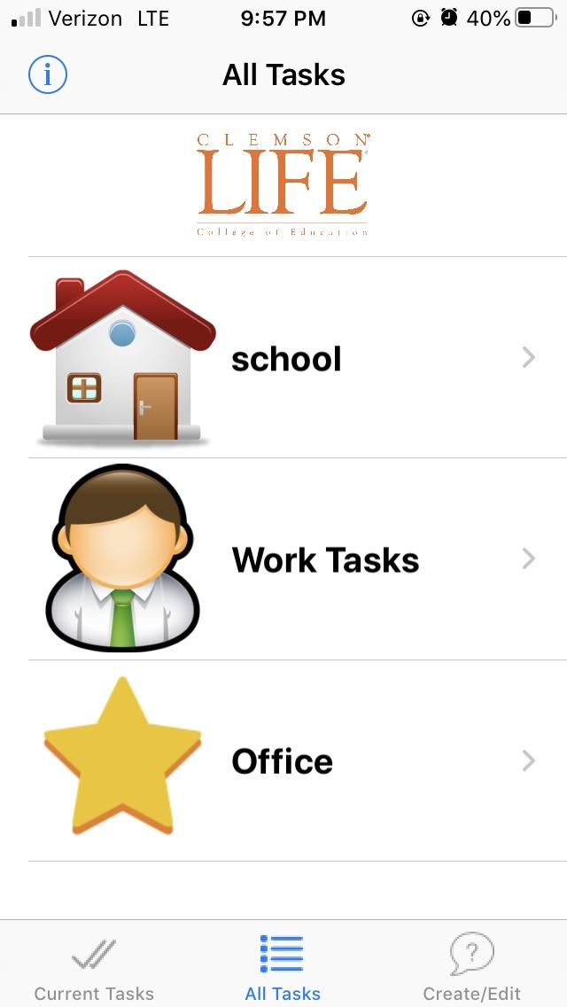
All Tasks
Users can go to a list of all the tasks by tapping the “All Tasks” tab at the bottom of the screen.
Notes:
Photo of navigating to All Tasks

Slide 26
Task Features
You can:
Save tasks in different categories.
Use Location Settings to automatically access tasks in preset locations.
Change the category names or icons in edit.
Notes:
Photo of all tasks; describe that you can create categories of tasks. You can set location services to access the particular tasks in particular locations. You can change the icons and the titles of the categories.

Slide 27
Task Features: Setting Locations
Home
Brush Teeth
Make Bed
Work
Folding Napkins
Restocking coffee supplies
Making copies
School
Morning Routine
Turning in homework
Yoga class
GPS feature that auto-populates tasks based on the user’s location.
See more in the Task Analysis App tutorial.
Clemsonlife.org/TA
Notes:
tr

Slide 28
Access Task Categories
Users can access the tasks in a category by tapping the category.
Notes:
Photo of navigating to All Tasks

Slide 29
List of Tasks
The task list provides an overall picture of a task and a label for each task.
Tap the task to go to the list of steps.
Notes:
Photo of the Task List.

Slide 30
Overall Video
On the task view, users tap the “Overall Video” to play a continuous video of all your recorded steps.
Notes:
Photo of the Task List.

Slide 31
Step by Step
On the task view, users tap “Step by Step” to see a list of all the programmed steps.
Notes:
Photo of the Task List.

Slide 32
Step Prompts
In the list of steps, users can reference four types of prompts. There is a picture prompt.
Notes:
Photo of the Task List.

Slide 33
Step Prompts
Users can reference the text prompt.
Notes:
Photo of the Task List.

Slide 34
Step Prompts
Users can reference the auditory prompt.
Notes:
Photo of the Task List.

Slide 35
Step Prompts
Users can reference the video prompt.
Notes:
Photo of the Task List.

Slide 36
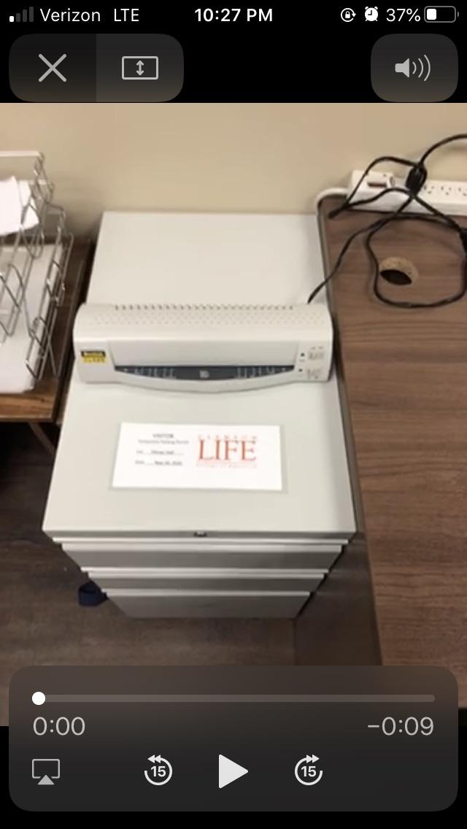
Video Prompts
The video prompt automatically plays when a user access the video prompt.
Notes:
Photo of the Task List.

Slide 37
Video Prompts
The video prompt automatically plays when a user access the video prompt.
The user can replay the video prompt by tapping the play button.
Notes:
Photo of the Task List.

Slide 38
Video Prompts
The video prompt automatically plays when a user access the video prompt.
The user can replay the video prompt by tapping the play button.
The user closes the video prompt screen by tapping the “X.”
Notes:
Photo of the Task List.

Slide 39
Task Analysis LIFE App
Interactive Demonstration
Notes:
Here is a sample of creating a task analysis for addressing an envelope.

Slide 40
Time to Download the App!!
With an iOS device,
Go to the Apple App Store.
Notes:
tr

Slide 41
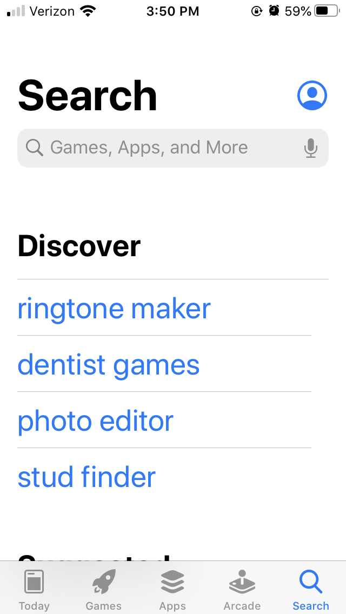
Search the Apple App Store
Search “TaskAnalysisLife” or
“Roy Pargas”
in the App Store.
Notes:
Picture of search in App store

Slide 42
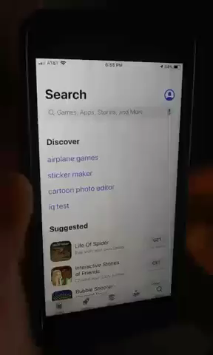
Search the Apple App Store
Search “TaskAnalysisLife” or
“Roy Pargas”
in the App Store.
Notes:
Video of search in App store

Slide 43
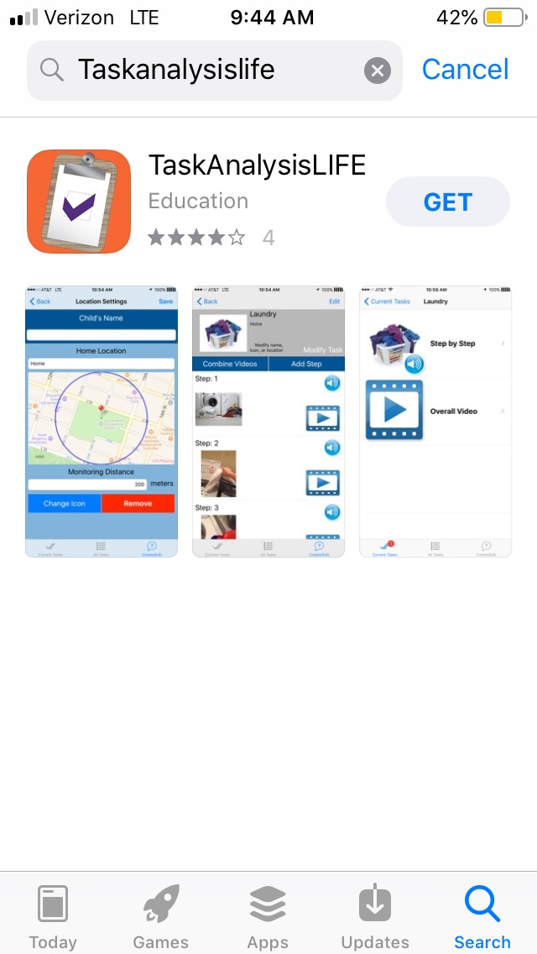
Download the App
1. Tap “GET”
Or
Notes:
Picture of download in app store

Slide 44
Download the App
Tap “GET”
Or
Notes:
Video of download in app store

Slide 45
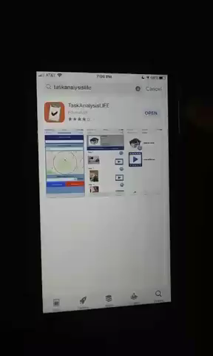
Open the TaskAnalysisLIFE App
Tap “OPEN”
Tap “Allow” to receive Notifications (i.e., alarm alerts)
Notes:
Video Open App and talk about making a passcode

Slide 46
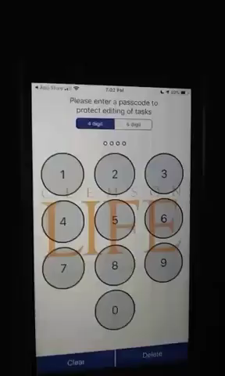
Create a Passcode
Enter 4-digit passcode twice.
Tap “Allow” to grant permission for app to access your location to use Location Services.
Notes:
Video of entering passcode and describing location services

Slide 47
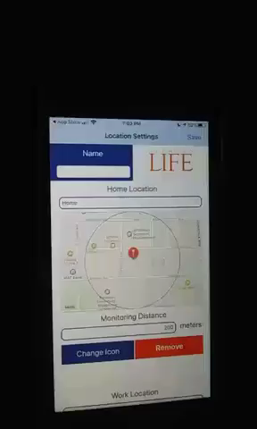
Save Location Setting
Tap “SAVE” in Location Settings.
Note: See the Location Settings tutorial (Clemsonlife.org/TA) to set each location.
Notes:
Video to save location settings and be at current tasks screen

Slide 48
Navigate to the Edit Screen
Tap “Create/Edit” on the bottom right corner of the screen.
Enter your password.
Notes:
Photo of navigate to edit screen

Slide 49
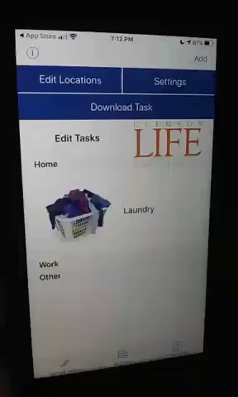
Create a New Task
Tap “Add” in upper right of screen.
Notes:
Video “Name Overall Task” but doesn’t name the task

Slide 50
Name the Task
Tap in the field under “Name.”
Enter the name of the task. This is what the user will see on the list of tasks.
Notes:
Photo of naming the task

Slide 51
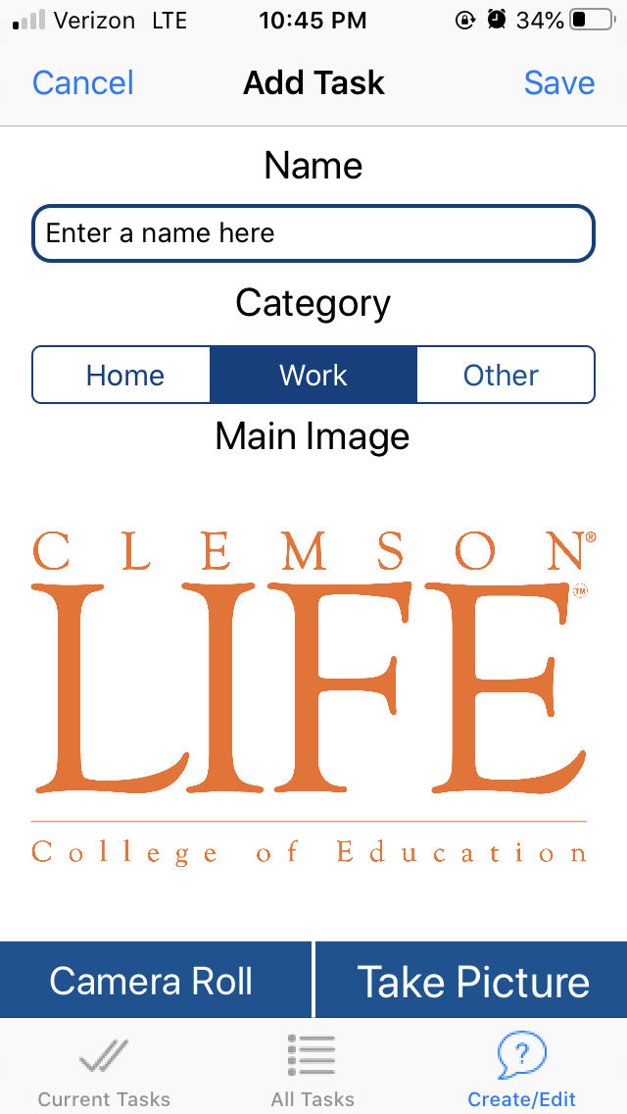
Select Task Category
Tap “Work” for the task to show up in the list of work tasks.
Tap “Home” for the task to show up in the list of home tasks.
Tap “Other” for the task to show up in the list of other tasks
Notes:
Picture of Add Task Screen

Slide 52
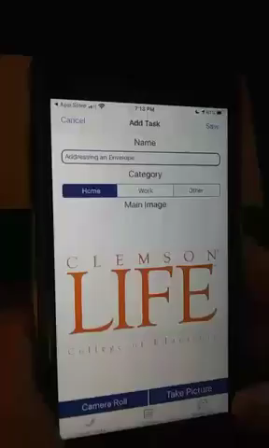
Take Picture of Overall Task
Tap “Take Picture.”
Tap “OK” to allow access to access the camera.
Notes:
Video; Describe tapping “Take Picture” before you play the video; This is the picture of the task you will see on the All Tasks Screen.

Slide 53
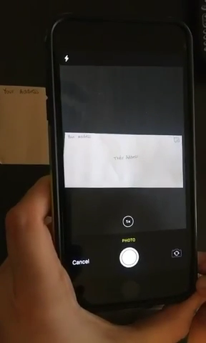
Take Picture of Overall Task
1. Take a picture of the task by tapping the white circle.
3. Tap “Use Photo.”
4. Tap “Save.”

Slide 54
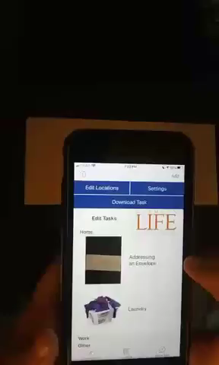
Add a Step
Select the task.
Tap “Add Step.”
Tap in the “Click here” box to add an image, audio, or video.

Slide 55
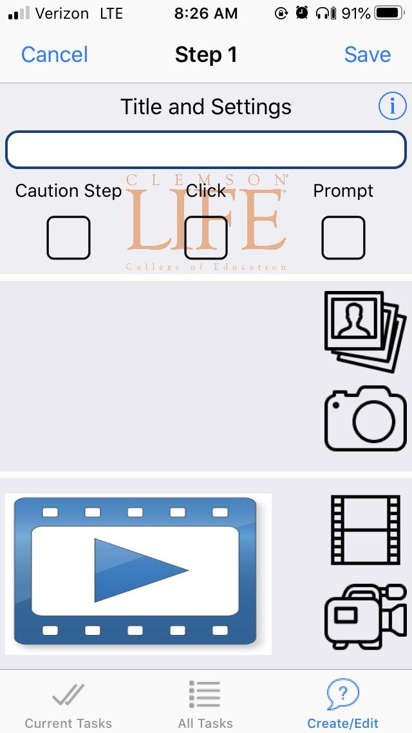
Add a Step: Name the Step
Tap in the Title Box.
Enter the name of the step.
Tap somewhere else on the screen to minimize the keyboard.
Notes:
Just a picture; no video

Slide 56
Add a Step: Use a Previously Recorded Video
Tap the film icon.
Tap “OK” when asked for access to your photos.
Tap the video (in your photos).
Notes:
Just a picture; no video

Slide 57
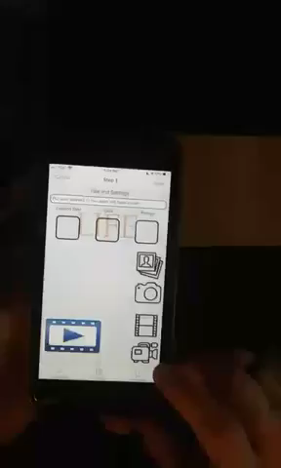
Add a Step: Record Video Prompt
Tap the video camera.
Tap the red button to record.
Record video.
Tap the red button when finished recording your video.
Notes:
tr

Slide 58
Add a Step: Use a Previously Taken Photo
Tap the pictures icon to access a picture in the device’s camera roll.
Tap the desired camera roll photo album.
Tap the desired photo.
Tap the red button when finished recording your video.

Slide 59
Add a Step: Take a Photo of the Step
Tap the camera icon.
Tap the white button to take a picture.
Tap “Use Photo.”

Slide 60
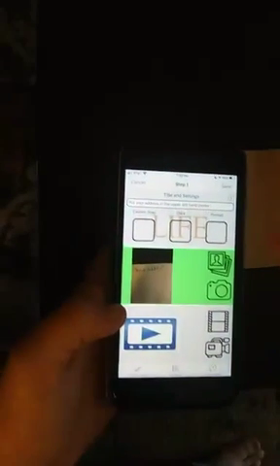
Add a Step: Save the Step
Tap “Save.”
Tap “Yes” to confirm saving the step.
Tap “Add Step” to add more steps.
Notes:
tr

Slide 61
Add More Steps
Add the Title.
Add a picture of the step.
Add a video of the step.

Slide 62
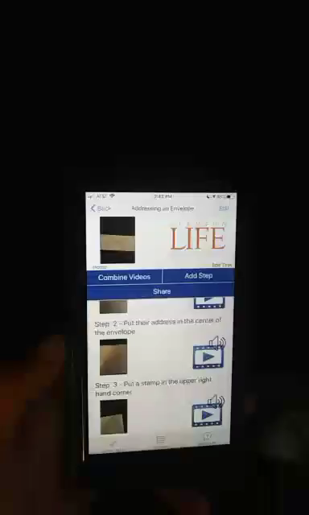
App Features: Combining Videos
Notes:
Video; combine videos

Slide 63
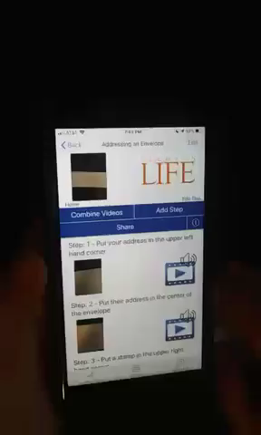
App Features: Share the Video Prompt
Notes:
Video of share

Slide 64
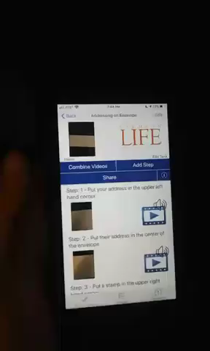
App Features: Download a Task
Navigate to Edit Screen.
Tap “Download Task.”
Enter code.
Note: You may have to wait a while for the task to download depending on the number and length of the videos in the task analysis and the strength of the Wi-Fi signal.
Notes:
tr

Slide 65
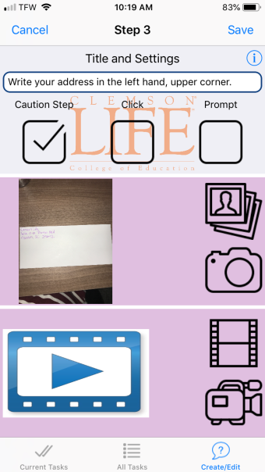
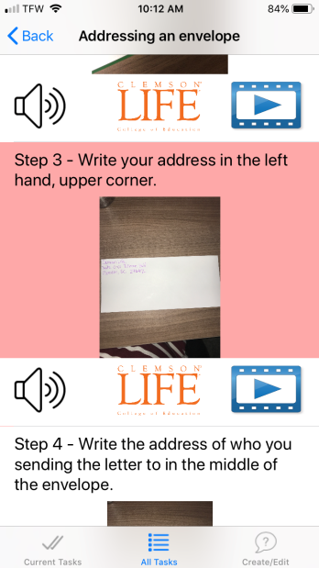
Step Features: Task Click
Tap “Caution Step” on the Task Set-up Page so that step is highlighted in pink.
Notes:
Video: click feature

Slide 66
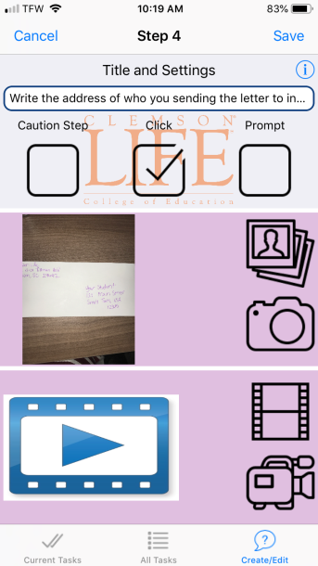
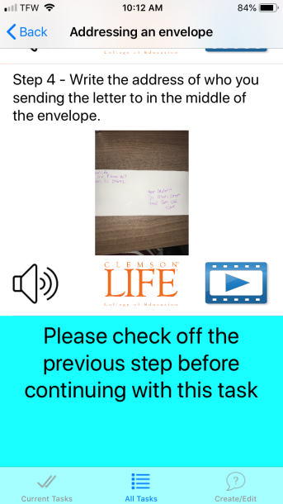
Step Features: Task Click
Tap “Click” on the Task Set-up Page so that user has to click on the picture of the task before seeing the next step.

Slide 67
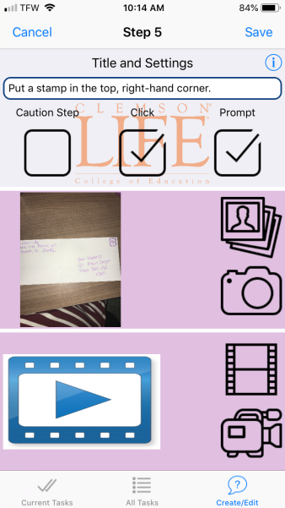
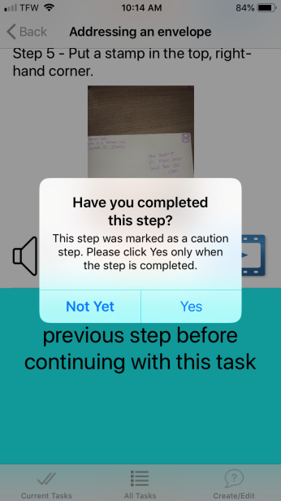
Step Features: Task Prompt
Tap “Prompt” on the Step Set-up Page for the user to see a pop-up asking them if they are sure that they completed the step.
Notes:
Video: use of prompt feature

Slide 68
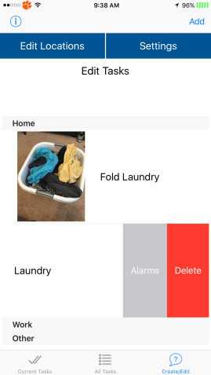
App Features: Edit Tasks Page
Location Edits
Swipe Task to
Delete Tasks
Swipe Task to
Set Alarms

Slide 69
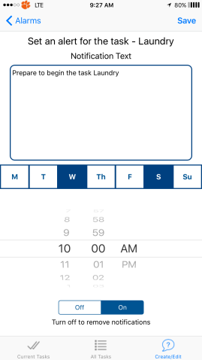
App Features: Alarm
Enter what the alert notification will say
Set alarm notification day and time
Turn notifications on or off

Slide 70
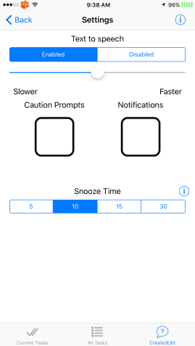
App Features: Text-to Speech and Snooze
Text-to-Speech & speech speed
Allowing caution prompts
& notifications
Set snooze time

Slide 71
Meal Planner App
Customize recipes for users to allow healthy choices for meal planning.
Practice checking ingredients and shopping independently with a grocery list.
Text to Speech feature.

Slide 72
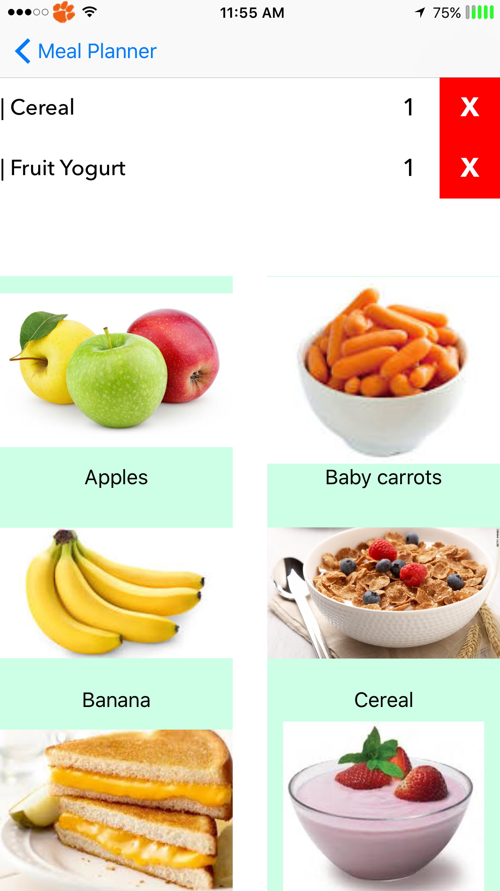
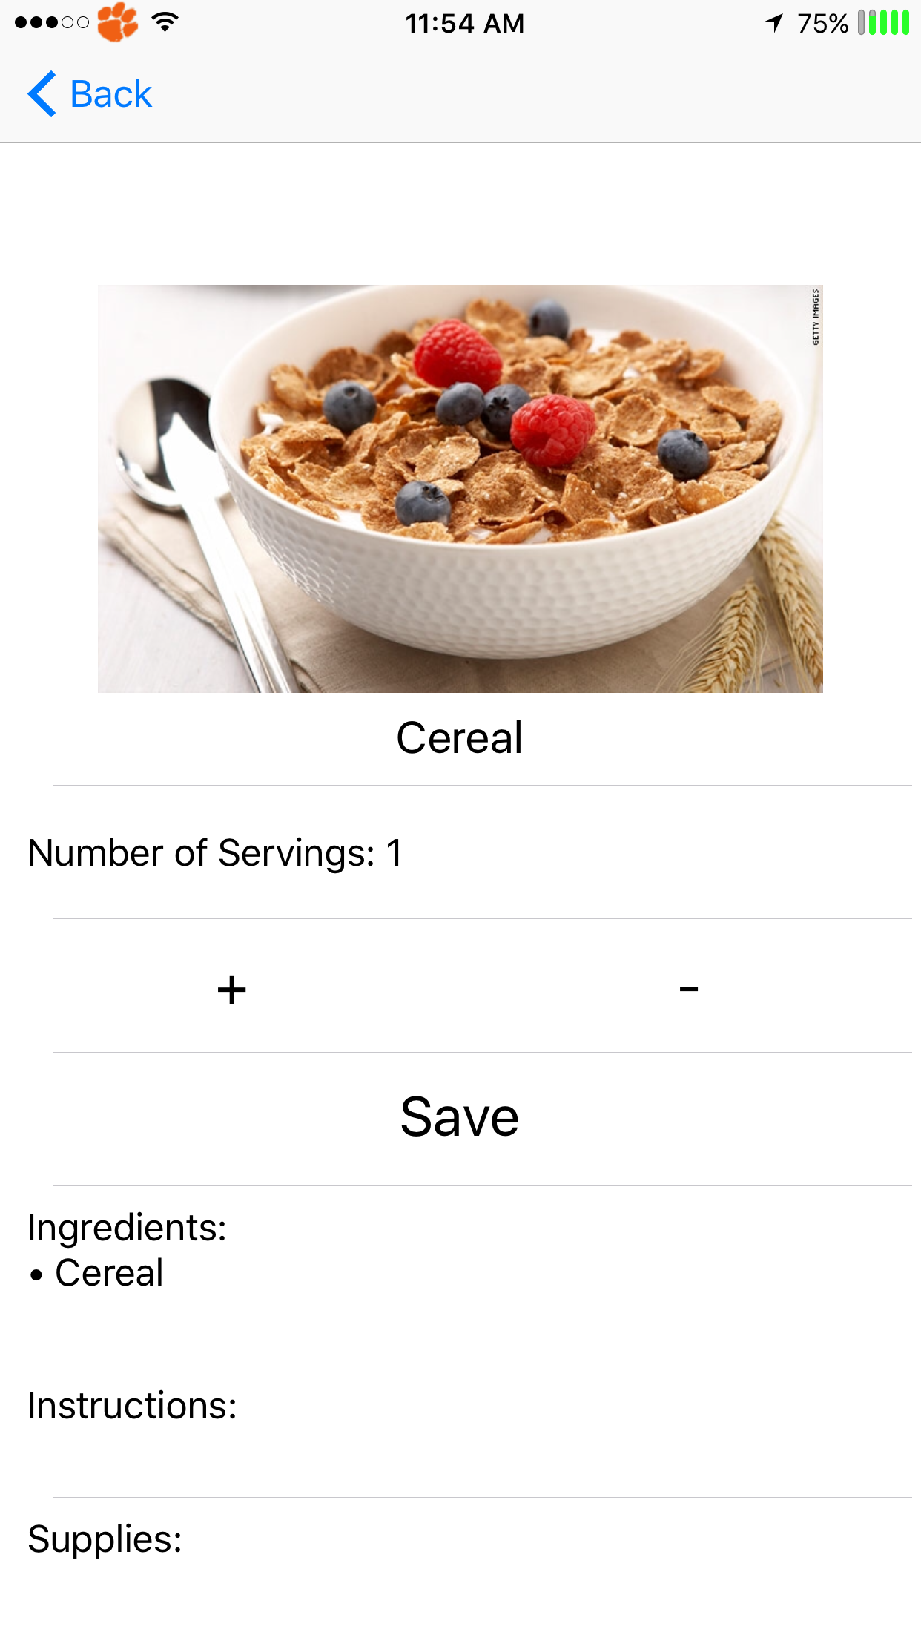
Meal Planner App
Meal Planner

Slide 73
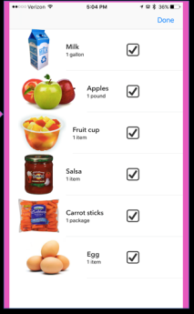
Meal Planner App
Generates Shopping List
Inventory of Pantry

Slide 74
Navigation App
Not yet available in the App store.
Job coaches/parents customize navigation routes.
Picture, audio and text support.
Notes:
jc

Slide 75
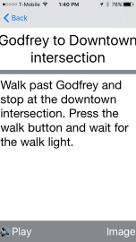
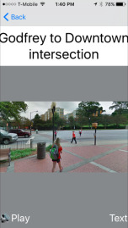
Navigation App
Large Text
Picture Support
Notes:
jc

Slide 76
Tutorials & Help
Task Analysis
Clemsonlife.org/TA
Meal Planner
Clemsonlife.org/MP
Navigation
Clemsonlife.org/N
Feedback
Clemsonlife.org/Feedback
32
Notes:
tr

Slide 77
Contact Us
Sharon Walters, MA, CCC-SLP
swalte4@g.Clemson.edu
Jordan Stierle, M.Ed.
jstierl@g.Clemson.edu

Slide 78
References
Cannella-Malone, H., Sigafoos, J., O’Reilly, M., De la Cruz, B., Edrisinha, C., & Lancioni, G. E. (2006). Comparing video prompting tovideo modeling for teaching daily living skills to six adults with developmental disabilities. Education and Training in Developmental Disabilities, 41(4), 344-356
Chan, W., Smith, L. E., Hong, J., Greenberg, J. S., Lounds Taylor, J., & Mailick, M. R. (2018). Factors associated with sustained community employment among adults with autism and co-occurring intellectual disability. Autism: The International Journal of Research & Practice, 22 (7), 794-803. https://doi.org/10.1177/1362361317703760
Graves, T. B., Collins, B. C., Schuster, J. W., & Kleinert, H. (2005). Using video prompting to teach cooking skills to secondary students with moderate disabilities. Education and Training in Developmental Disabilities, 40(1), 34-46.
Hong, E., Ganz, J., Ninci, J., Neely, L., Gilliland, W., & Boles, M. (2015). An evaluation of the quality of research on evidence-based practices for daily living skills for individuals with autism spectrum disorder. Journal of Autism & Developmental Disorders, 45(9), 2792-2815. https://doi.org/10.1007/s10803-015-2444-3.
Van Laarhoven, T., & Van Laarhoven-Myers, T. (2006). Comparison of three video-based instructional procedures for teaching daily living skills to persons with developmental disabilities. Education and Training in Developmental Disabilities, 41(4), 365-381.

